Slide 1
Knowing Machine Learning
Enrique Ortuno

Slide 2
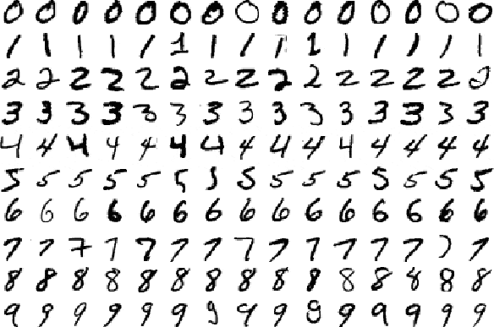
Motivation

Slide 3

What is this?

Slide 4
What is Machine Learning? - Definition
ML is a field of study which harnesses principles of computer science and statistics to create statistical models. These models are generally used to do two things:
Prediction: make predictions about the future based on data about the past
Inference: discover patterns in data

Slide 5
Theoretical Sample
Create a model to predict based on premise: taller people make more money than shorter people
f(x) = x²
Model that predicts income from height.
Income = Height × $1,000
….
What could be a best model?
What about earthqueakes?

